Slide 1



PROBLEM STATEMENT:
Many individuals struggle to maintain their health due to a lack of awareness and failure to grasp the seriousness of maintaining good overall health and negligence of mental health due to societal stigma.

Slide 2

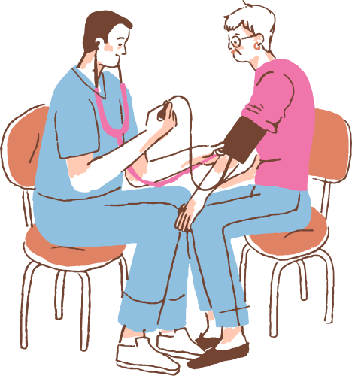

PURPOSE:
To educate and raise awareness on improving physical and mental health.
TARGET AUDIENCE:
General Public

Slide 3
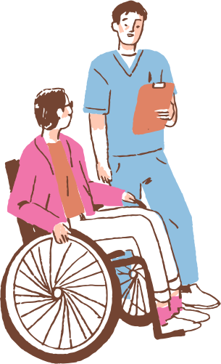

INTRODUCTION:
Did you know that over 1 in 4 people globally suffer from mental health issues, yet many of us neglect the vital connection between our physical and mental health.
Have you ever noticed that when you’re physically active, you feel more energized and less stressed? Or when you’re feeling mentally drained, your physical health can take a hit too?
If you want to achieve true well-being, its essential that we care for both. Understanding this connection can empower us to make healthier choices and improve the quality of our lives.

Slide 4

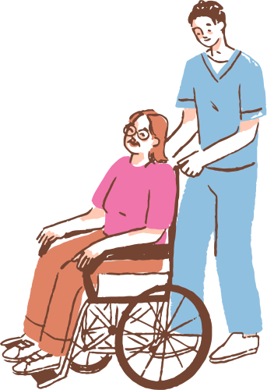
PHYSICAL HEALTH:
It includes being free from illness, having good nutrition, exercising and managing body systems.
MENTAL HEALTH:
It includes well-being, how people think, feel and act.
It also includes importance of mental health in managing stress, emotions and relationships

Slide 5
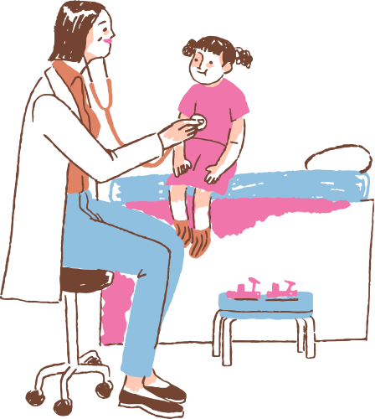

HOW MENTAL HEALTH AFFECTS PHYSICAL HEALTH:
Mental health disorders like depression and anxiety are associated with a suppressed immune system, making the body more susceptible to infections and slower to heal from illnesses.

Slide 6
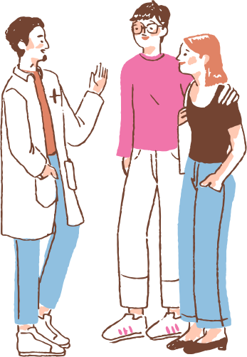
HOW WE PLAN TO APPROACH:
We have built a website to track steps, heart rate, water intake, calories ,etc to track our everyday physical fitness goals and track our mental well-being by educating ourselves on various mental disorders.

Slide 7
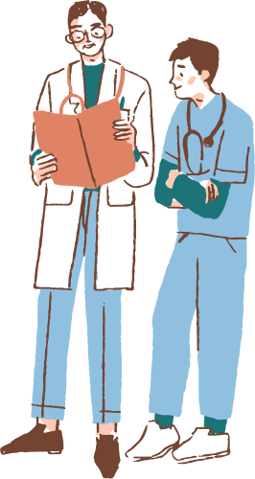
WHAT WE PLAN ON DOING OVERNIGHT:
Improve design aspect on our webpage.
Make a chatbot and add more features.

Slide 8
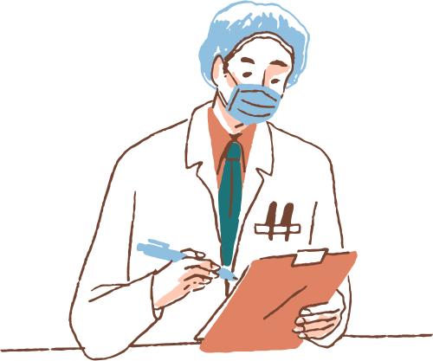

THANK YOU

